Slide 1
Customer Segmentation & Prediction Using RFM Analysis
Name: Saurabh Sahare
Program: Business Analytics / Data Science
Project Type: Capstone Project

Slide 2

Agenda
Problem Statement
Objective
Dataset Overview
Methodology
RFM Analysis
Customer Segmentation
Dashboard Overview
Key Insights
Business Recommendations
Conclusion

Slide 3

Problem Statement :
Businesses struggle to understand customer behavior
No clear identification of high-value vs low-value customers
Lack of personalized marketing strategies
High customer churn due to poor engagement

Slide 4

Objective
Segment customers based on behavior using RFM
Identify high-value and at-risk customers
Build a prediction model for customer value
Provide actionable business insights

Slide 5

Dataset Overview
Transactional E-commerce Data
Features include:
InvoiceNo (Transaction ID)
Product Description
Quantity & Price
Customer ID
Country
Dataset Size : 541909 rows including Null Values
Derived Features
Recency – Days since last purchase
Frequency – Total number of purchases
Monetary – Total spend

Slide 6
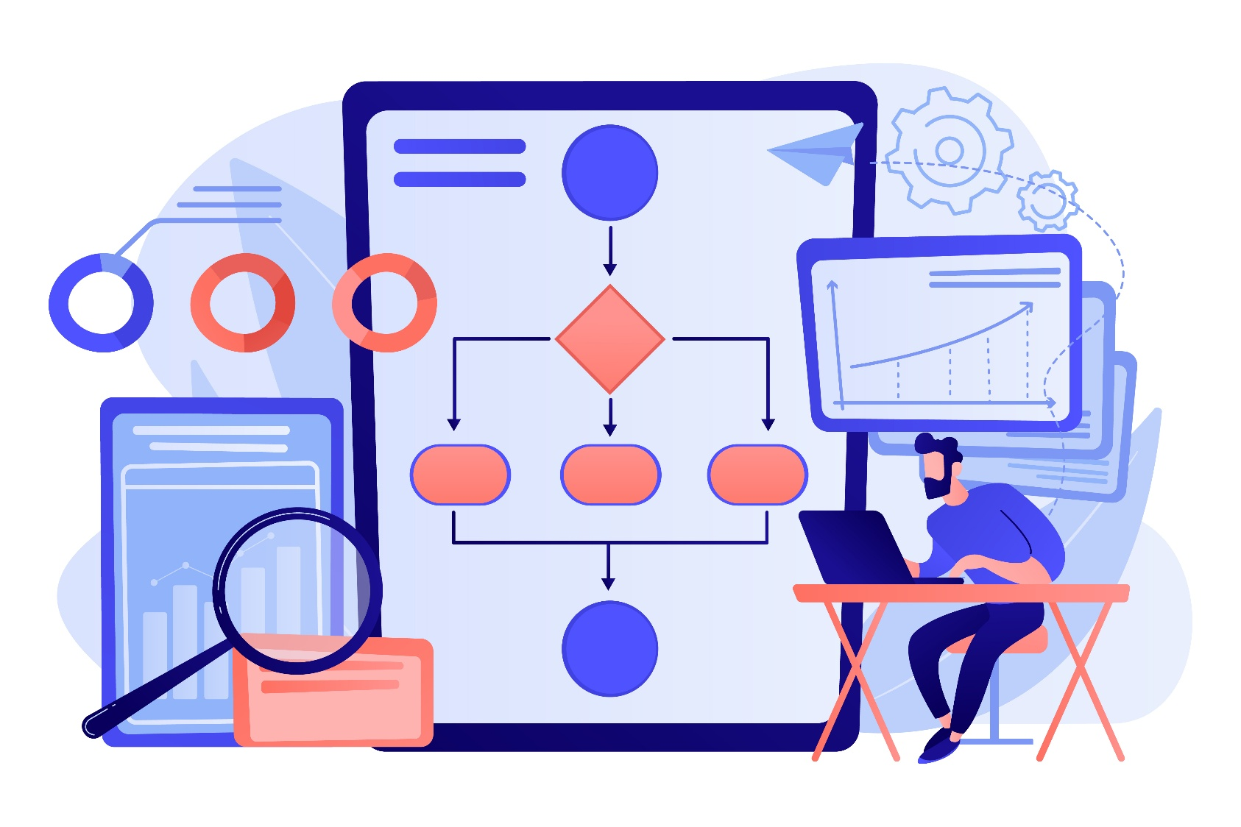
Methodology
Data Cleaning & Preprocessing
Feature Engineering (RFM)
Scaling of data
K-Means, Hierarchical, Dbscan Clustering for segmentation
Classification Model for prediction

Slide 7
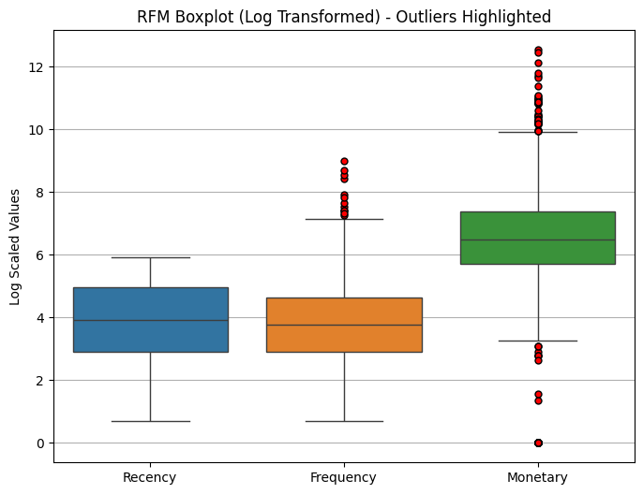
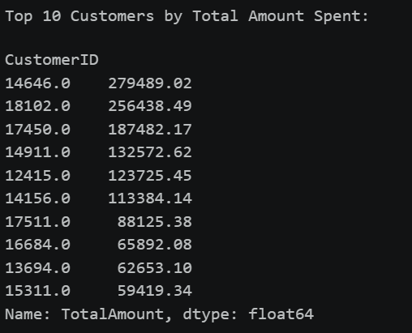
Exploratory Data Analysis (EDA)
RFM Analysis
Log transform used to reduce skewness
Monetary has highest spread → revenue varies most
Outliers = high-value customers
Frequency shows some heavy buyers
Recency is relatively stable

Slide 8

Why K-means Cluster
Provides clear and well-defined customer segments
Easy to interpret for business (High Value, At Risk, Regular)
Produces fixed number of clusters (useful for marketing strategies)
Works well with RFM features (Recency, Frequency, Monetary)
Scalable for large datasets
Why NOT DBSCAN
Generates noise points (-1 cluster)
Clusters are inconsistent and unpredictable
Difficult to explain to business stakeholders
Not suitable for structured segmentation
Why NOT Hierarchical Clustering
Lower performance (lower silhouette score)
Computationally expensive for large datasets
Difficult to scale
Hard to define optimal number of clusters

Slide 9
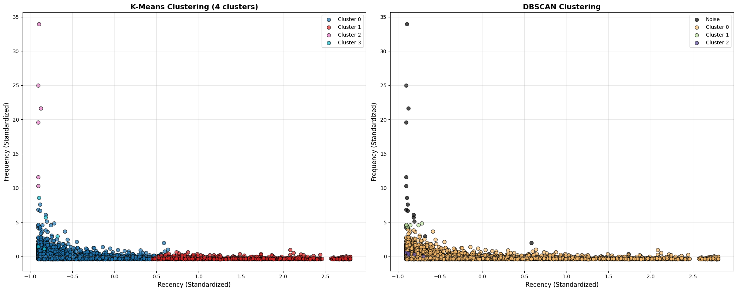
Comparison of K-means vs DBscan

Slide 10
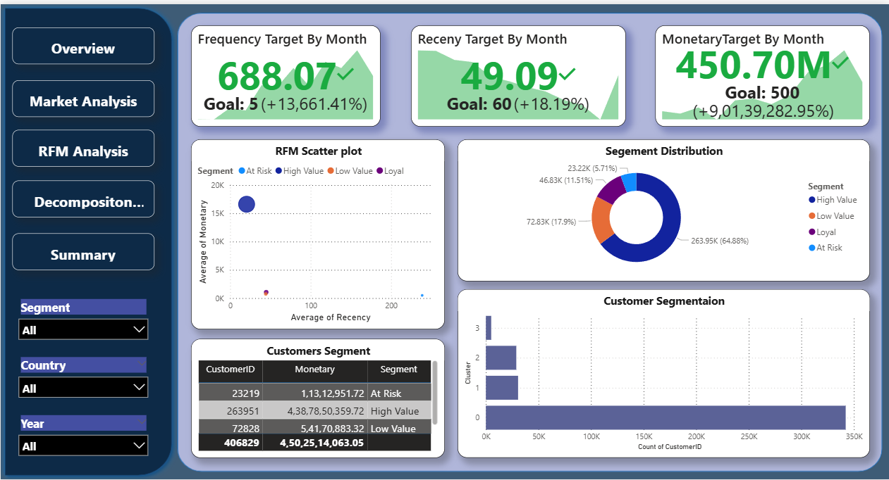
Dashboard Overview
Dashboard Insights
Frequency (688) significantly exceeds target → strong customer activity
Recency (~49 days) below target → customers are actively engaged
Monetary (~450M) close to target → strong overall revenue
RFM Scatter Insights
High Value customers show high monetary + low recency
Clear separation between customer segments
Few customers contribute disproportionately high revenue

Slide 11
Key Insights
Business Recommendations
Majority revenue is driven by high-value customers (~65%)
Monetary shows high variation → few customers contribute most revenue
Low recency = strong engagement (active customer base)
At-risk customers exist but are currently low in proportion
Frequency is very high → repeat purchase behavior is strong
Clear segmentation → easy to target customers differently
Focus on retaining high-value customers (VIP programs, exclusives)
Launch win-back campaigns for at-risk customers
Convert low-value customers via cross-sell & upsell strategies
Introduce loyalty rewards & personalized offers
Use segmentation for targeted marketing instead of mass campaigns
Prioritize customer retention over acquisition

Slide 12

Conclusion
Identified clear customer segments using RFM-based clustering
A small group of customers contributes to major revenue (High Value segment)
Significant number of customers fall into At-Risk category
Frequency and Monetary are the most important factors driving customer value
Customers with high Recency indicate potential churn risk
Revenue is concentrated among loyal and frequent buyers
Customer behavior patterns enable targeted marketing strategies
Dashboard provides interactive insights for better decision-making

Slide 13
Thank You!

